Slide 1
Entrada – CMI NA-IS Hackathon
Team Name: DevOps Automation Champ
Account: Experian
Team Lead: Muni Chandra
Team Members : Suresh Madala, Sudha Rani

Slide 2
Brief Overview
Automate the deployment of APIs with Docker and AWS ECS Fargate using Terraform script
Theme
Need common infrastructure to manage the deployment of Microservices API without managing the instances and without manual intervention.
Need to provision instances quickly and handle the dynamic loads.
Need to easily deploy the application across multiple environment.
Terraform by HashiCorp—allow you to express your infrastructure resources as code and manage them programmatically.
Scope
Terraform is cloud-agnostic and allows a single configuration to be used to manage multiple providers, and to even handle cross-cloud dependencies.
The terraform script can be reused to deploy the application in other cloud providers like google cloud, azure .. Etc. So end client can easily shift from one cloud provider to other.
Re-Usability

Slide 3
High Level Solution Approach
ECS, ECR, EC2, LoadBalancer full access and IAM access
Pre-Requisites
Input
Processing
Output
Developed a Currency-exchange-service which converts one currency to other. So it needs input as from currency like USD, to like INR and quantity. /currency-exchange/from/USD/to/INR/quantity/10
Developed the Currency-exchange-service API with H2 in memory db which has currency exchange rates like below 'USD','INR',75, 'EUR','INR’,80, 'AUD','INR',25,0, 'CAD','INR',53,0.
This service will accept the inputs like currency from, to and quantity as URL path parameters and returns output as conversionMultiple, totalCalculatedAmount.
Created the Dockerfile to create the docker image.
Pushed the image to AWS ECR and then run the terraform script to create the cluster, services and task in the AWS ECS.
"from":"USD","to":"INR","conversionMultiple":75.00,"quantity":10,"totalCalculatedAmount":750.00,"port":8080

Slide 4
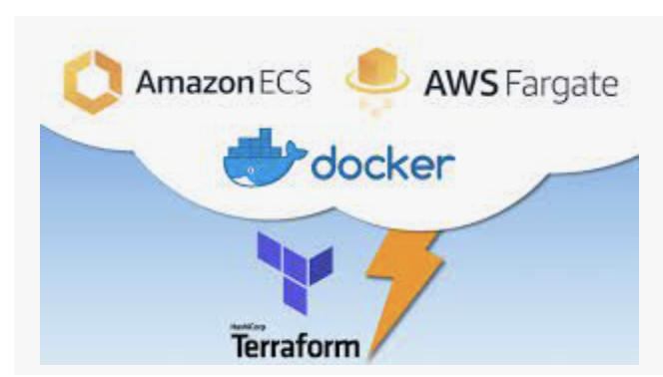
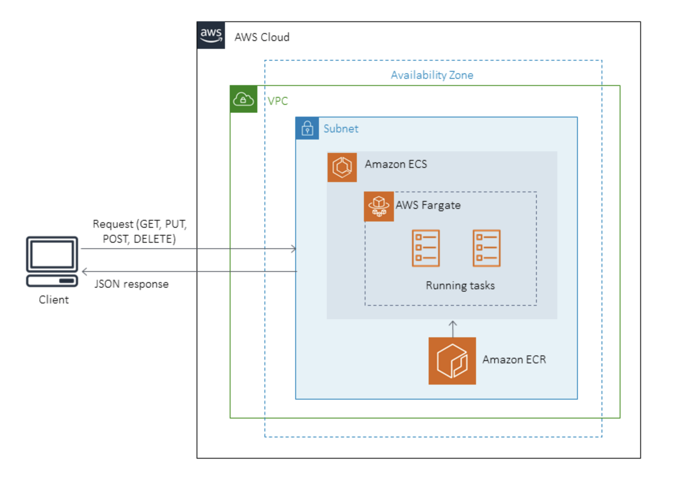
High Level Architecture
AWS Project
Deployment Highlights:
Single Region - US East Deployment
ECS cluster, fargate, service and task
Spring Boot Application hosted on AWS
Run terraform script to deploy the application in AWS ECS

Slide 5
Deliverables
Developed the currency-exchange-service spring boot application api – http://204.236.208.235:8080/currency-exchange-service/currency-exchange/from/USD/to/INR/quantity/10
curl --location --request POST http://204.236.208.235:8080/currency-exchange-service/currency-exchange/from/USD/to/INR/quantity/10
and provides output as json format - {"from":"USD","to":"INR","conversionMultiple":75.00,"quantity":10,"totalCalculatedAmount":750.00,"port":8080}
Dockerfile – used to create the docker images using Docker build –t name .
Terraform script is written and it consists of :
Variables.tf - we declare the variables required for vpc , subnet and task role name.
main.tf - just declare the cloud provider we are using and also region.
currency_exchange_api_service.tf – We define the task definition file, aws_ecs_service, aws_ecs_cluster.
Task definition is the definition for the ECS task, that describes how and what should be run in and around your container.
aws_ecs_service – It provides to use launch type “Fargate”, role for creating the service
Cluster creates the cluster of service

Slide 6
Live Demo

